Slide 1
Naïve Bayesian
J.H. Lee, School of ICE, Sungkyunkwan Univ.

Slide 2

Tennis Playing
Tennis playing record
 | Outlook | Temp | Humidity | Wind | Play
1 | Sunny | Hot | High | Weak | No
2 | Sunny | Hot | High | Strong | No
3 | Overcast | Hot | High | Weak | Yes
4 | Rain | Mild | High | Weak | Yes
5 | Rain | Cool | Normal | Weak | Yes
6 | Rain | Cool | Normal | Strong | No
7 | Overcast | Cool | Normal | Strong | Yes
8 | Sunny | Mild | High | Weak | No
9 | Sunny | Cool | Normal | Weak | Yes
10 | Rain | Mild | Normal | Weak | Yes
11 | Sunny | Mild | Normal | Strong | Yes
12 | Overcast | Mild | High | Strong | Yes
13 | Overcast | Hot | Normal | Weak | Yes
14 | Rain | Mild | High | Strong | No
J.H. Lee, School of ICE, Sungkyunkwan Univ.

Slide 3


Tennis Playing
Today is Sunny, Mild, High and Strong
  Will he play tennis today?
How can you predict his tennis playing?
  Let’s use Probability
J.H. Lee, School of ICE, Sungkyunkwan Univ.

Slide 4
Tennis Playing
Naïve Bayesian Classifier
  Probability with the strongest assumption on independence
If Output is given,
Inputs are independent from each other.
J.H. Lee, School of ICE, Sungkyunkwan Univ.

Slide 5

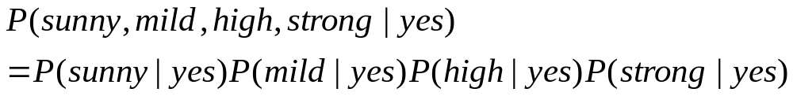
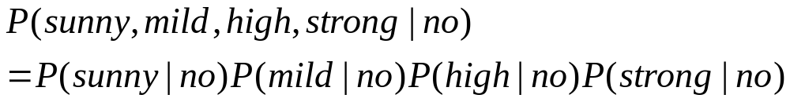
Tennis Playing
Naïve Bayesian Classifier
By assumption of indepenence
Do we need to evaluate this?
Can we evaluate this?
J.H. Lee, School of ICE, Sungkyunkwan Univ.

Slide 6
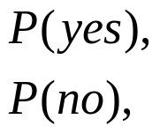
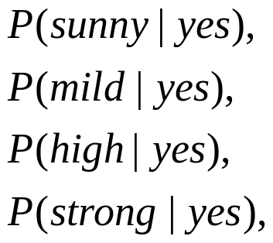
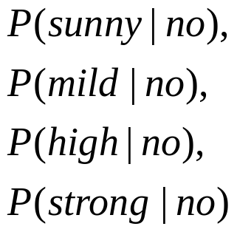
Tennis Playing
Naïve Bayesian Classifier
  Let’s ESTIMATE the followings, but HOW?
 | Outlook | Temp | Humidity | Wind | Play
1 | Sunny | Hot | High | Weak | No
2 | Sunny | Hot | High | Strong | No
3 | Overcast | Hot | High | Weak | Yes
4 | Rain | Mild | High | Weak | Yes
5 | Rain | Cool | Normal | Weak | Yes
6 | Rain | Cool | Normal | Strong | No
7 | Overcast | Cool | Normal | Strong | Yes
8 | Sunny | Mild | High | Weak | No
9 | Sunny | Cool | Normal | Weak | Yes
10 | Rain | Mild | Normal | Weak | Yes
11 | Sunny | Mild | Normal | Strong | Yes
12 | Overcast | Mild | High | Strong | Yes
13 | Overcast | Hot | Normal | Weak | Yes
14 | Rain | Mild | High | Strong | No
J.H. Lee, School of ICE, Sungkyunkwan Univ.

Slide 7
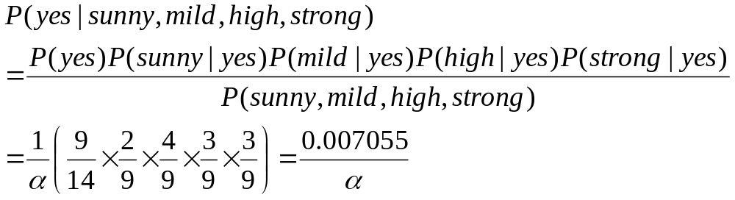

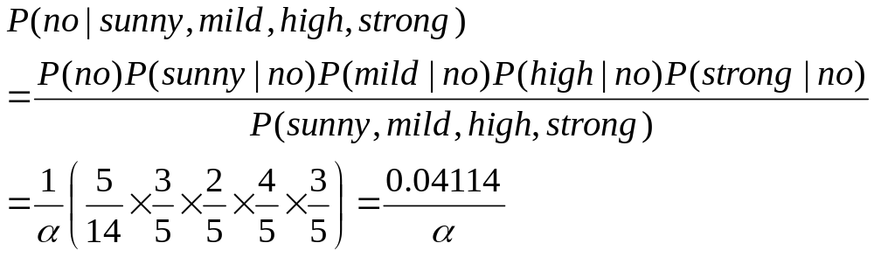
Tennis Playing
Naïve Bayesian Classifier
Will he play or not?
J.H. Lee, School of ICE, Sungkyunkwan Univ.

Slide 8
Performance
Conditional independence assumption is often violated
but it is easy to implement and works surprisingly well anyway
When to use:
  Moderate or large training set available
  Attributes that describe instances are conditionally independent given classification
Successful applications:
  Diagnosis
  Classifying text documents: spam or non-spam

Slide 9
Discussion
Let’s do it once more with the following data
Today is Sunny, Mild, High and Strong
  Will he play tennis today?
 | Outlook | Temp | Humidity | Wind | Play
1 | Sunny | Hot | High | Weak | No
2 | Sunny | Hot | High | Strong | No
3 | Rain | Mild | High | Weak | Yes
4 | Rain | Cool | Normal | Strong | No
5 | Sunny | Mild | High | Weak | No
6 | Rain | Mild | Normal | Weak | Yes
7 | Overcast | Mild | High | Strong | Yes
8 | Rain | Mild | High | Strong | No
J.H. Lee, School of ICE, Sungkyunkwan Univ.

Slide 10
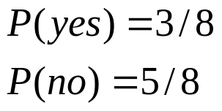
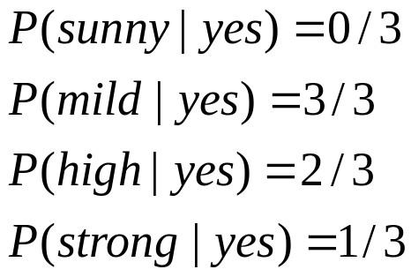
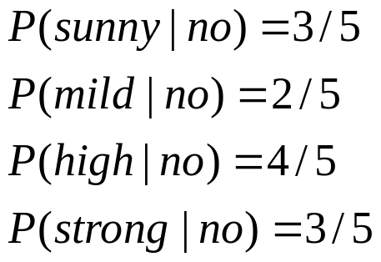
Discussion
Naïve Bayesian Classifier
  Let’s ESTIMATE the followings, but HOW?
 | Outlook | Temp | Humidity | Wind | Play
1 | Sunny | Hot | High | Weak | No
2 | Sunny | Hot | High | Strong | No
3 | Rain | Mild | High | Weak | Yes
4 | Rain | Cool | Normal | Strong | No
5 | Sunny | Mild | High | Weak | No
6 | Rain | Mild | Normal | Weak | Yes
7 | Overcast | Mild | High | Strong | Yes
8 | Rain | Mild | High | Strong | No
??
J.H. Lee, School of ICE, Sungkyunkwan Univ.

Slide 11
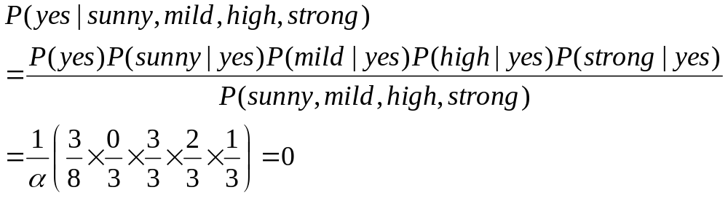
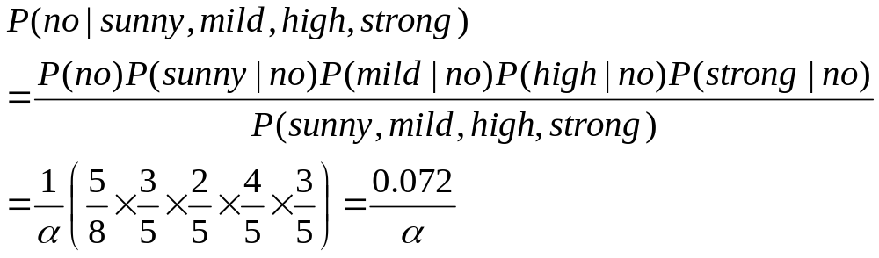
Discussion
Naïve Bayesian Classifier
Is it OK?
J.H. Lee, School of ICE, Sungkyunkwan Univ.

Slide 12
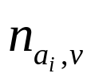
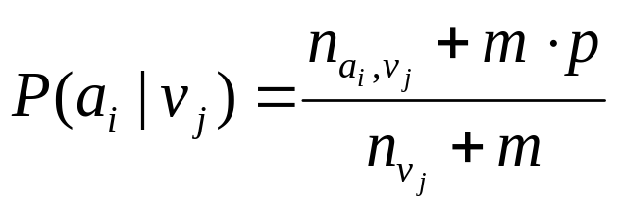

Discussion
If the size of given data or the number of instances for a specific value is small, NBC gives a poor performance
When is very small:
  : number of training examples for which v=v_{j}
  : number of examples for which v=v_{j} and a=a_{i}
  p is a prior estimate
  m is weight given to prior
J.H. Lee, School of ICE, Sungkyunkwan Univ.

